Slide 1
STQA IV
TY BSC IT Mumbai University

Slide 2
Software Verification and Validation (V&V)
Software Verification and Validation (V&V) is a process that ensures software meets its specified requirements and functions correctly and reliably. It is a critical part of software quality assurance (SQA) and helps in detecting defects early in the development lifecycle.

Slide 3
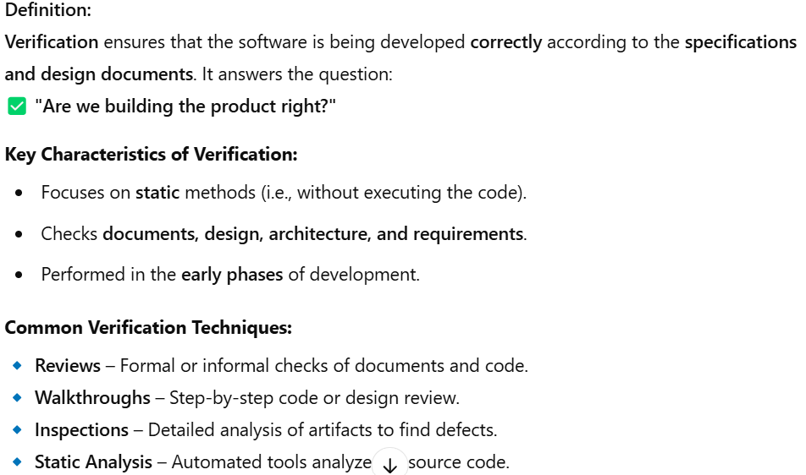
1. Software Verification

Slide 4
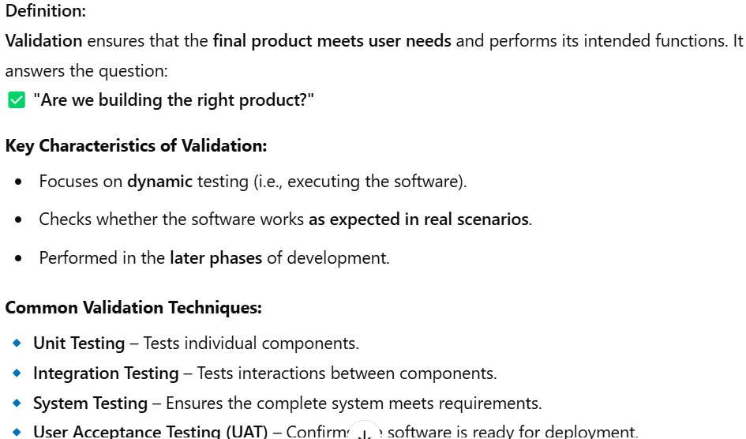
2. Software Validation

Slide 5
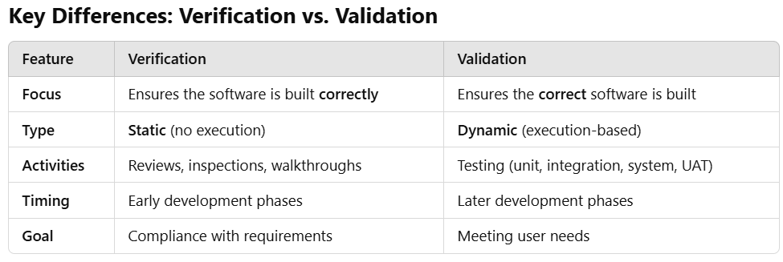

Slide 6
Verification Workbench
The Verification Workbench is a structured framework used to systematically verify that a software product meets its requirements and design specifications. It consists of a set of tools, techniques, and processes to ensure that software is being developed correctly before it moves to the validation phase.

Slide 7
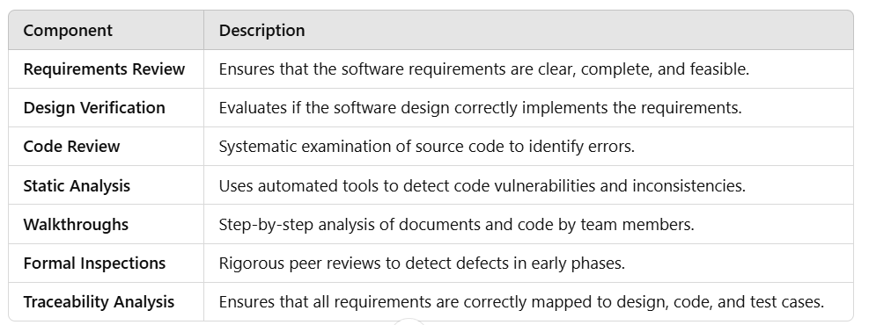
Key Components of the Verification Workbench

Slide 8
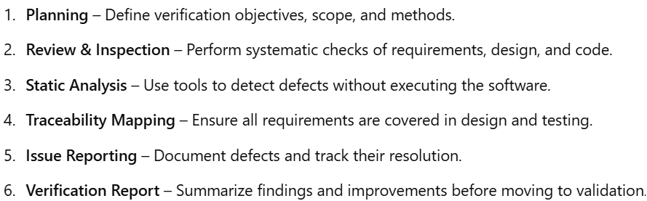
Process of Using the Verification Workbench

Slide 9
Methods of Verification in Software Testing
Software Verification ensures that the software is built correctly by checking whether it meets design specifications, coding standards, and requirements before execution. It is a static process that does not involve running the software.

Slide 10
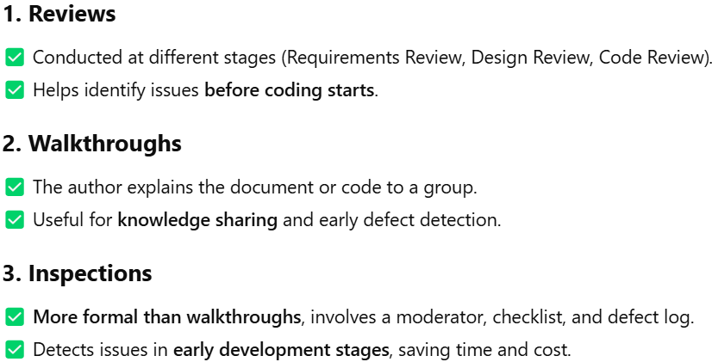

Slide 11
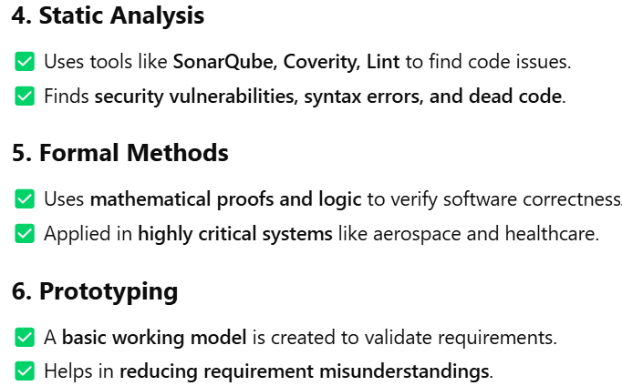
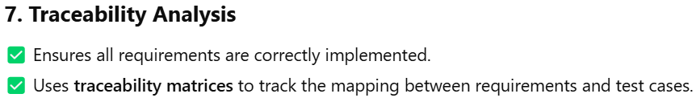

Slide 12
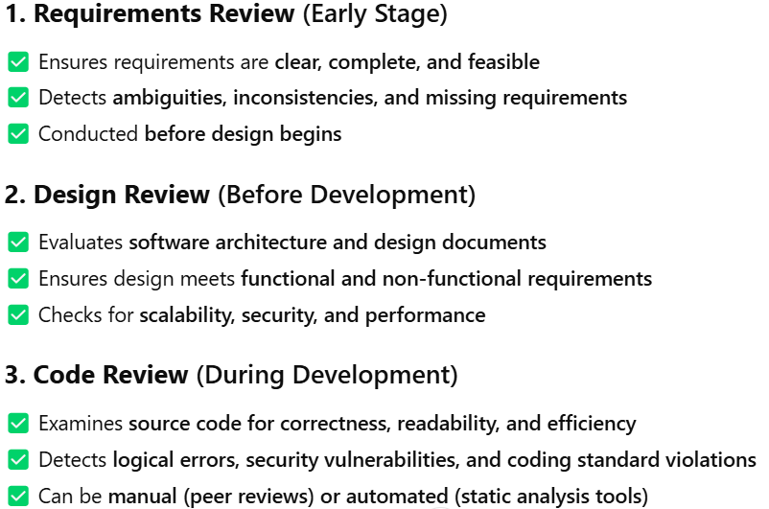
Types of Reviews Based on Stage/Phase

Slide 13
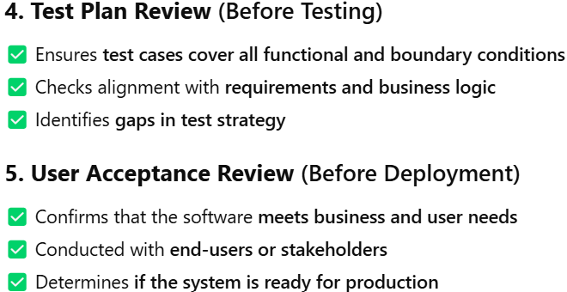

Slide 14
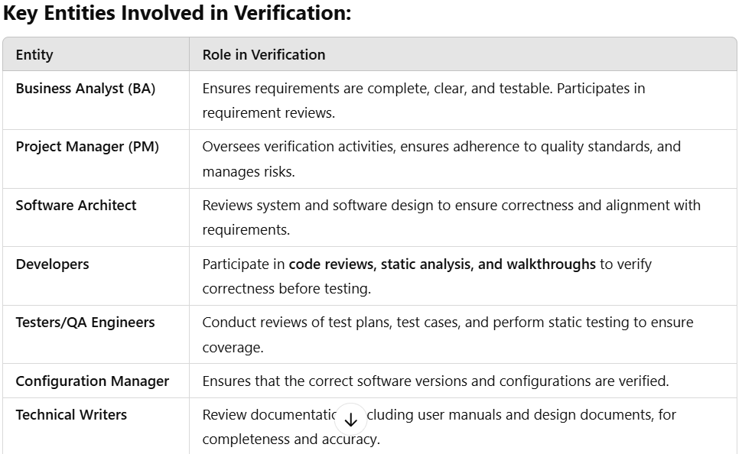
Entities Involved in Software Verification

Slide 15
Reviews in the Software Testing Lifecycle
Reviews in the software testing lifecycle are systematic evaluations of software artifacts to identify defects early in the development process. These reviews help improve software quality, reduce rework, and ensure compliance with requirements before formal testing begins

Slide 16
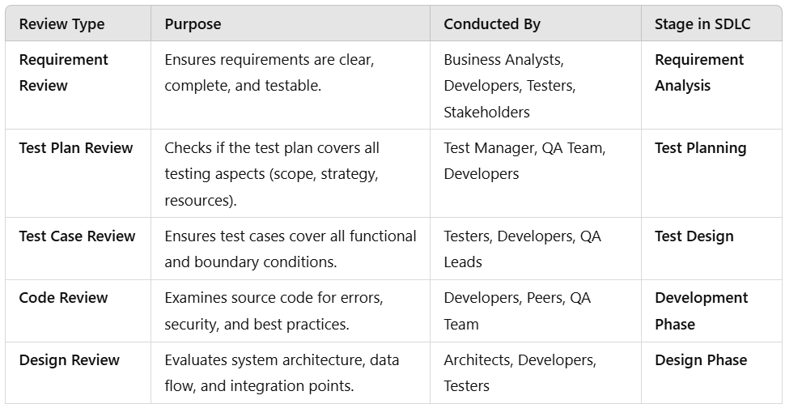
Types of Reviews in the Testing Lifecycle

Slide 17
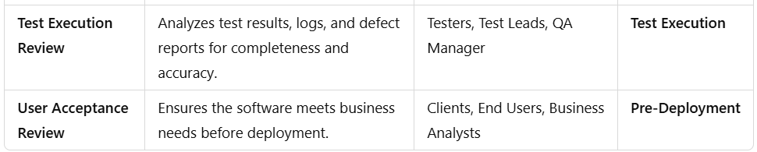

Slide 18
Coverage in Verification
Coverage in Verification refers to the extent to which software artifacts (requirements, design, and code) are checked against specified standards to ensure correctness before execution.
It ensures that all aspects of the software are verified to detect defects early in the development lifecycle.

Slide 19
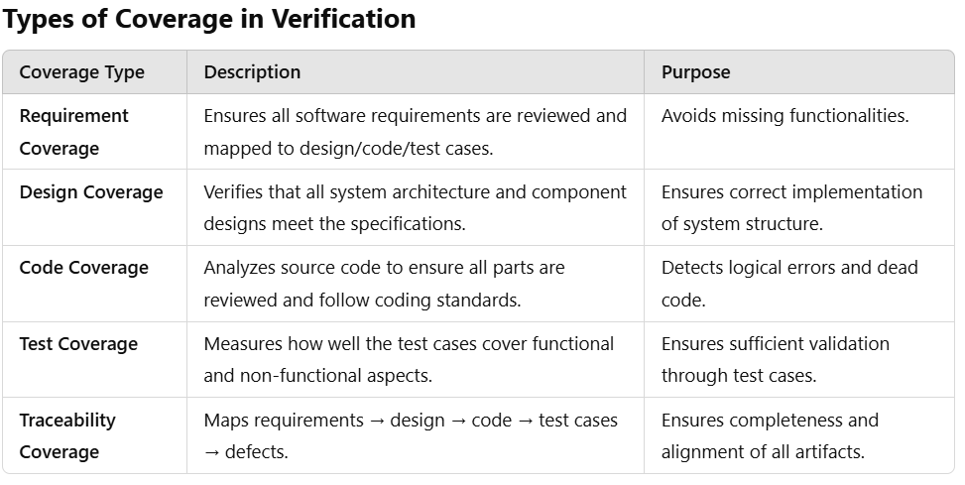

Slide 20
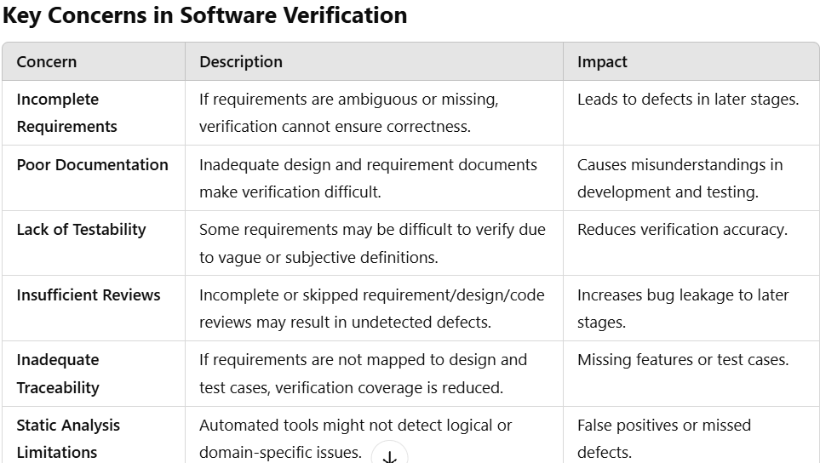
Concerns of Verification in Software Testing
Software Verification ensures that the software product is developed correctly as per the specifications. However, several concerns can impact the effectiveness of verification.

Slide 21
Software Validation
Software Validation is the process of ensuring that the final software product meets the intended requirements and functions as expected in a real-world environment. It answers the question:
✅ "Are we building the right product?"
Unlike verification, which checks if the product is being built correctly, validation ensures that the end product meets user needs and performs its intended function

Slide 22
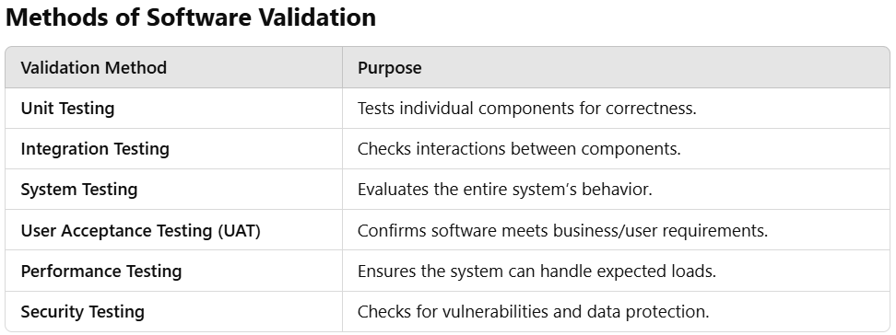

Slide 23
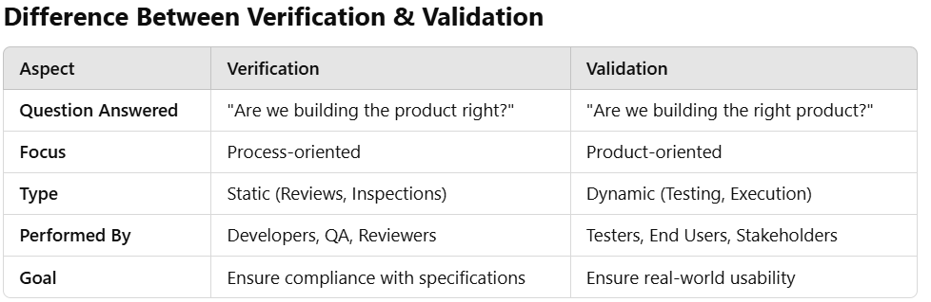

Slide 24
Validation Workbench
In software testing, the term "Validation Workbench" refers to specialized tools or frameworks designed to facilitate the validation process, ensuring that software products meet their intended requirements and function as expected.
These tools assist testers in structuring, executing, and monitoring validation activities across various testing phases.

Slide 25
Key Examples of Validation Workbenches:
Security Weaver's Validation Workbench: This tool streamlines the testing of SAP roles and authorizations by automating the creation of test environments. It generates test user accounts and assigns necessary roles, enhancing communication between administrators and testers. This automation reduces the time and complexity associated with authorization testing.
Appvance's Validation Workbench: As a submodule within the Appvance platform, this tool enables the creation and modification of structured and personalized validations. It allows for automatic verification of test conditions, contributing to efficient test design and execution.

Slide 26
Levels of Validation
Unit Testing: This level involves testing individual components or modules of the software to ensure they function correctly in isolation. It verifies that each unit performs as designed.
Integration Testing: At this stage, multiple units are combined and tested as a group to identify issues in their interactions. The goal is to detect interface defects between modules.
System Testing: This comprehensive testing evaluates the complete and integrated software product. It assesses the system's compliance with specified requirements.
Acceptance Testing: Conducted to determine whether the system meets the acceptance criteria and is ready for deployment. This testing is often performed by end-users or clients to validate the software's functionality in real-world scenarios.

Slide 27
Additionally, the validation process can be broken down into specific stages to ensure thorough evaluation:
Design Qualification (DQ): Involves creating a list of end-user business requirements and designing a validation testing plan to address them before launching the product.
Installation Qualification (IQ): Ensures that the software is installed correctly and that the test environment matches the intended production environment.
Operational Qualification (OQ): Involves testing the product with various operations to ensure it meets specified user requirements. This includes unit testing, integration testing, and system testing.
Performance Qualification (PQ): Verifies that the product performs according to business needs in real-world conditions. This stage often includes alpha and beta testing.

Slide 28
Coverage in validation
In software testing, test coverage is a critical metric that measures the extent to which the application's code, functionalities, or features are exercised by the test cases.
It provides insight into which parts of the application have been tested and identifies areas that may require additional attention.

Slide 29
Types of Test Coverage:
Product Coverage: This technique assesses various parts or modules of the application to ensure comprehensive testing. For example, in a shopping cart application, product coverage would involve testing functionalities like adding or removing items, handling maximum item limits, and managing out-of-stock scenarios.
Risk Coverage: Focuses on identifying and thoroughly testing high-risk elements within the application. For instance, in an e-Commerce app, a critical risk element could be the integration with third-party payment gateways. Testing would involve scenarios such as successful payment processing, handling payment failures, and ensuring secure data transmission.
Requirements Coverage: Ensures that the application meets all specified customer requirements. This involves verifying that each feature and functionality aligns with the documented expectations and performs as intended.

Slide 30
Code Coverage: Measures the extent to which the source code has been tested. It includes various metrics such as:
Function Coverage: Determines whether each function in the code has been invoked during testing.
Statement Coverage: Assesses whether each executable statement has been executed.
Branch Coverage: Evaluates whether all possible branches (e.g., in conditional statements) have been tested.
Condition Coverage: Checks whether all boolean expressions have been evaluated to both true and false

Slide 31
Management of Verification and Validation
Planning and Strategy:
Define clear objectives: Establish specific goals for V&V activities, aligning them with project requirements and stakeholder expectations.
Develop a V&V plan: Outline the scope, methods, resources, and timelines for verification and validation activities.
Identify critical areas: Prioritize V&V efforts on critical components and functionalities of the software.
Establish acceptance criteria: Define clear criteria for evaluating the success of V&V activities.

Slide 32
Verification Activities:
Requirements review: Conduct thorough reviews of requirements documents to ensure clarity, completeness, and consistency.
Design inspections: Inspect design documents to identify potential flaws and ensure adherence to standards.
Code reviews: Review code to detect errors, ensure code quality, and enforce coding standards.
Testing: Perform various types of testing, including unit testing, integration testing, and system testing, to verify that the software meets specified requirements.

Slide 33
Validation Activities:
User acceptance testing (UAT): Involve end-users in testing the software to ensure it meets their needs and expectations.
Beta testing: Release the software to a limited number of users for real-world testing and feedback.
Usability testing: Evaluate the user interface and user experience to ensure ease of use and effectiveness.
Performance testing: Assess the software's performance under various conditions to ensure it meets performance requirements.

Slide 34
Management and Control:
Traceability: Maintain traceability between requirements, design elements, code, and test cases to ensure comprehensive coverage.
Configuration management: Manage and control changes to software artifacts to maintain consistency and avoid errors.
Defect tracking: Track and manage defects identified during V&V activities, prioritizing their resolution.
Metrics and reporting: Collect and analyze metrics to assess the effectiveness of V&V activities and identify areas for improvement.
Communication: Establish clear communication channels among stakeholders to ensure effective collaboration and timely feedback.

Slide 35
Continuous Improvement:
Lessons learned: Capture lessons learned from V&V activities to improve future processes.
Process improvement: Continuously evaluate and improve V&V processes to enhance efficiency and effectiveness.
Tooling: Utilize appropriate tools to support V&V activities, such as test management tools, defect tracking tools, and code analysis tools.

Slide 36
Software development verification and validation activities.
Verification Activities (Are we building the product right?):
Requirements Review:
Goal: Ensure requirements are clear, complete, consistent, and testable.
Activities:
Reviewing requirements documents with stakeholders.
Identifying ambiguities, inconsistencies, or missing information.
Ensuring requirements are traceable and prioritized.

Slide 37
Design Inspections: Goal: Evaluate software design to identify potential flaws and ensure adherence to standards.
Activities:
Inspecting design documents (architecture, modules, interfaces).
Checking for design flaws, inefficiencies, or security vulnerabilities.
Ensuring design aligns with requirements and coding standards.
Code Reviews: Goal: Examine code to detect errors, ensure code quality, and enforce coding standards.
Activities:
Manual code reviews by developers.
Static code analysis using automated tools.
Identifying potential bugs, code smells, or security issues.

Slide 38
Testing: Goal: Verify that the software meets specified requirements.
Activities:
Unit testing: Testing individual components or modules.
Integration testing: Testing interactions between components.
System testing: Testing the entire software system.
Non-functional testing: Performance, security, usability testing.

Slide 39
Validation Activities (Are we building the right product?):
User Acceptance Testing (UAT):
Goal: Involve end-users to ensure the software meets their needs and expectations.
Activities:
End-users test the software in a real-world environment.
Providing feedback on usability, functionality, and performance.
Determining if the software meets user acceptance criteria.
Beta Testing: Goal: Release the software to a limited number of users for real-world testing and feedback.
Activities:
Gathering feedback from beta users on their experience.
Identifying any remaining bugs or usability issues.
Using feedback to improve the software before final release.

Slide 40
Usability Testing: Goal: Evaluate the user interface and user experience to ensure ease of use and effectiveness.
Activities:
Observing users interacting with the software.
Collecting data on user performance and satisfaction.
Identifying areas for improvement in the user interface
Performance Testing: Goal: Assess the software's performance under various conditions.
Activities:
Load testing: Testing the software under heavy load.
Stress testing: Testing the software beyond normal limits.
Performance testing: Measuring response times and resource usage.

Slide 41
What is V Model in Software Testing?
V Model in Software testing is an SDLC model where the test execution takes place in a hierarchical manner. The execution process makes a V-shape. It is also called a Verification and Validation model that undertakes the testing process for every development phase.
For instance, if the developers roll out a new feature. Only after the testing of that new feature is over does the next phase of the V model start.
The V model in Software testing is useful for providing a systematic and visual representation of the SDLC process in a sequential manner. The shape ‘V’ represents the development and testing phase occurring together before moving on to the next stage.

Slide 42
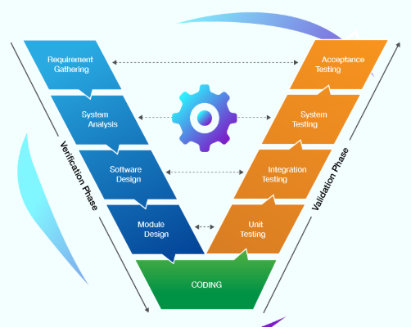

Slide 43
Importance of Software Model:
A software project involves many development life cycles, so selecting the correct one becomes difficult. Software Development Models require careful selection by looking at the budget, team size, project criticality, and criticality of the product.
Choosing the suitable model will improve the efficiency of your IT projects and manage risks associated with the software development lifecycle

Slide 44
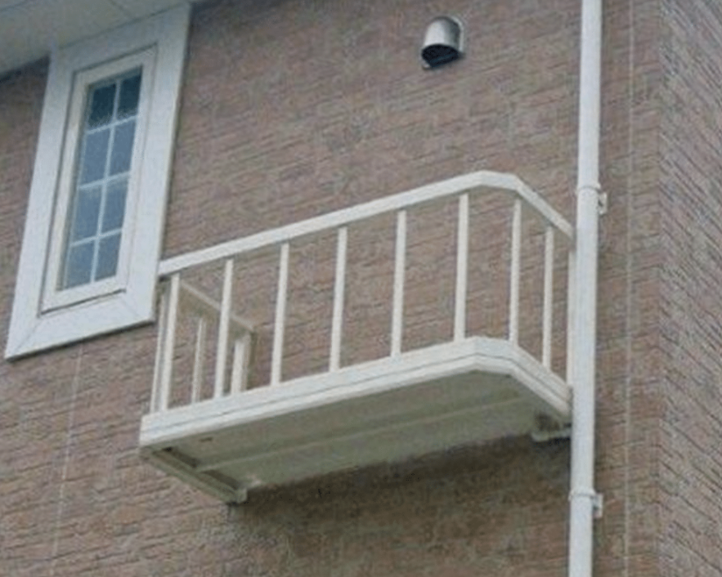


Slide 45
Importance of Correct Model
Looking at the PIC-1 and PIC-2 models, were you able to notice anything? Yes, you are right! PIC-1 shows mistakes in house construction, and the constructed balcony is not helpful as it is practically impossible for one can go there apart from, of course, you are a Spiderman. On the other hand, PIC-2 gives us an idea of practical, well-designed construction. It followed a proper design model before construction, whereas PIC1 has not. Hence, this needs reconstruction to make it correct.
In the case of PIC-1, the reconstruction cost is more as the issue comes into the picture late in the construction phase. Effective construction time tracking could have helped identify and address these issues earlier, reducing reconstruction costs and efforts significantly. We could have saved/minimized the reconstruction cost and efforts to the optimum level if a correct house model had been followed before construction or if the problem had been detected earlier in the construction phase.

Slide 46
The same rule applies in Software Engineering too. The necessity of correct software testing models in the Software Development Life Cycle (SDLC) is inevitable. Ideally, a Software Development Life Cycle consists of the following essential steps: 1. Planning 2. Analysis 3. Design 4. Implementation 5. Testing & Integration 6. Maintenance

Slide 47
V Model
Also known as the verification and validation model, the V model guides where testing needs to begin as early as possible in the SDLC life cycle. Testing is not only an execution-based activity. It also involves various activities that must be covered before the end of the coding phase. V Model corresponds to both testing activities and development activities in parallel.
The following diagram illustrates the different phases in a V Model of the SDLC.

Slide 48
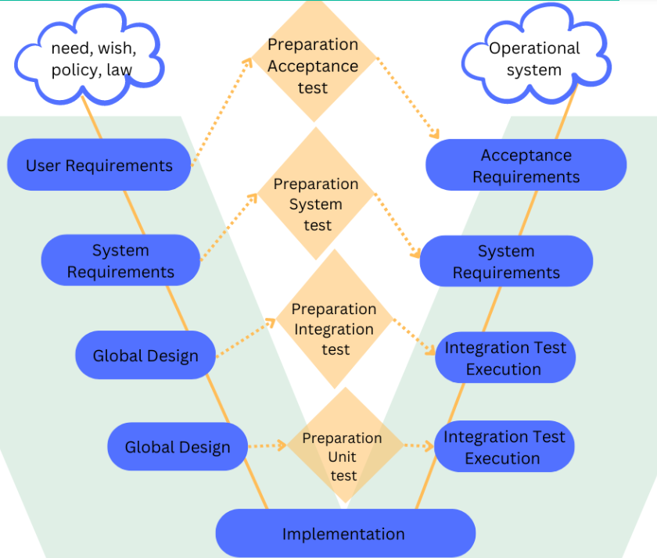

Slide 49
As shown above, the V Model contains Verification phases on one side and Validation phases on the other. The implementation/coding phase joins the verification and validation phases in V-shape. Thus it is called a V Model.
Now let’s deep dive into the V Model verification and validation phases.

Slide 50
Verification Phases of the V Model
1. User Requirements / Requirement Analysis:
Remember the example given at the beginning about house construction; before starting the construction work, an individual needs to gather specific details such as financial options, appropriate location, right contractor for constructing a house, construction and building materials, availability of water and electricity, etc.

Slide 51
Similarly, before starting any software project, the authorities would need to gather certain information, such as having a detailed discussion with customers to know and understand their exact requirements and expectations of the product.
Analyses of the gathered requirements need to be done, then refined and come up with accurate, consistent, and unambiguous requirements, mainly in the form of documents called Requirements Specification or Requirements Definition Documents.

Slide 52
This document will capture both the product’s functional and non-functional requirements and the requirement’s priority. The Requirements document is signed-off formally by the stakeholders, which becomes the basis for all further activity.
Based on this, the user acceptance criteria test cases are developed. The customers/stockholders, Business Analysts, and Project Managers are the key members of the requirement analysis phase

Slide 53
2. System Requirements:
Once we have collected the clear and detailed product requirements, the next phase i.e., system requirements begins in earnest. Taking the Requirements Specification inputs in this phase next Functional Requirements Specification or System Requirement Specification begins.
Business Analysts and Developer Leads take the user requirements and turn those into different features that the product should have at the end.
During this system requirement phase, teams will revisit and finalize the complete hardware requirements, resources, and communication setup for the product under development.
The system test plan is developed based on the system requirements phase. These requirements are segregated into different features, and features are grouped. Each feature is prioritized in this phase.

Slide 54
i. Global Design / High-Level Design:
The global design phase is also referred to as High-Level Design(HLD) phase. Each feature is again broken down into different modules in this phase.
The Architects, Developers, Database designers, and other required members take the elements segregated in the system requirements phase as input and develop an overall high-level technical design.
This high-level design document has all the required technical details, such as hardware, software, Programming language to be used, Database design, applications touch points, etc., clearly defined.
They built the HLD so that each module is associated with a specific function. This information allows integration tests to be designed and documented during this stage.

Slide 55
ii. Detailed Design / Low-Level Design:
In the next stage, the Technical Specification i.e. HLD, is taken as the input. Individual developers or the team use it to develop a detailed design of their modules and their interface with other modules.
Details about what type of data objects, how the data is to be collected, how the data can be integrated, business rules to be applied, and data storage are all documented in the detailed design Specification.
This intricate design specification/document is also referred to as Low-Level Design. In this phase, simultaneously, unit tests can be designed on the internal low-level design of each module.

Slide 56
3. Implementation Phase / Coding Phase:
Programmers or Developers take the Low-Level Design Specification and start the implementation process. The coding of each module designed in the detailed design phase is taken up in the coding/implementation phase.
The coding is performed based on the coding guidelines and standards of the specific language that is being used. The developed code goes through numerous code reviews-feedbacks, and implementation and is optimized for its best performance before the final build is checked into the source repository.

Slide 57
Validation Phases of the V Model
1. Component Test Execution/Unit Testing:
The component test execution phase is also referred to as component testing, unit testing, or module and program testing executed during the detailed design phases.
This validation testing phase searches for defects in and verifies the functioning of software’s different modules, programs, objects, classes, etc., separately testable.
Most often, component testing stubs and drivers are used to replace the missing software and simulate the interface between the software components to achieve the testing in isolation from the rest of the system.

Slide 58
Component testing may include different testing characteristics such as resource behavior, memory leaks, code coverage, robustness testing, etc. The detected defects are typically fixed as soon as they are found without formally recording the incidents.

Slide 59
2. Integration Test Execution/Integration Testing:
Primarily integration testing is carried out based on global or high-level design. The development team comes up with the technical specification and a corresponding integration for a test plan.
The details are noted of how the modules or programs will be integrated, data that will be passed through the interfaces, and additional integration testing approaches such as Big Bang, Top-Down, Bottom-up, or functional incremental, etc.

Slide 60
Integration testing is performed to expose the defects in the interfaces between components, interactions of different parts or systems such as an Operating System and File system, etc.
Here the main focus is on how other modules or components’ interaction works, not the functionality of the individual component.

Slide 61
3. System Test Execution/ System Testing:
System testing tests an integrated system/whole system or product to verify that it meets specified requirements. The main goal is to validate that the delivery system meets the design specifications.
The testing team performs complete or thorough testing in this phase, including system, functional, and non-functional test cases. Its purpose is to find as many defects as possible and report them.
System tests are generally executed in different development test environments. However, the test environments should correspond to the production environment as much as possible to minimize the risk of environment-specific bugs.

Slide 62
4. Acceptance Test Execution/User Acceptance Testing:
Acceptance test execution is associated with the requirements analysis phase. Testers review the Requirement specification and check whether the requirement has enough details to be tested, there is no ambiguity if non-functional requirements are mentioned as well, whether the requirements have been prioritized, and if product risks have been captured.
This Test plan is designed focused on conducting tests concerning the user needs, requirements, and business processes.
This determines whether or not the software product/system satisfies the acceptance criteria and enables the users, customers, or other authorized entities to determine whether or not to accept the system.

Slide 63
Principles of V Model
The principles of the V model are based on Verification and Validation, which you can find in the above sections. Here, we discuss the clear principles of the V model in Software testing:
From Large to Small: The first principle states that the testing needs to be done in a sequential process. It must start with identifying the requirements, creating a high-level, concise design, and detailing the design phases of the project.
Data and Process Integrity: This principle places emphasis on working with data and processes together to implement a successful project design.
Scalability: The V model undertakes the ability to accommodate any IT project despite the size, complexity, or duration.
Cross Reference: This principle establishes a direct correlation between requirements and corresponding testing activity.
Clear Documentation: Like in every other project, this principle shows how documentation is a requirement that needs to be done by both the developers and the support team.

Slide 64
Critical Roles and Responsibilities.
1. Project Manager:
Responsibilities:
Overall responsibility for V&V planning and execution.
Allocating resources (budget, personnel, tools) for V&V activities.
Monitoring V&V progress and ensuring it stays on track.
Communicating V&V results to stakeholders.
Making decisions based on V&V findings (e.g., whether to release the software).

Slide 65
2. V&V Lead/Manager:
Responsibilities:
Developing and maintaining the V&V plan.
Defining V&V strategies and methodologies.
Leading and coordinating V&V activities.
Managing the V&V team.
Reporting V&V status to the project manager.
3. Requirements Analyst:
Responsibilities:
Eliciting, analyzing, and documenting requirements.
Ensuring requirements are clear, complete, and testable.
Maintaining traceability between requirements and other artifacts.
Participating in requirements reviews.

Slide 66
4. Designers/Architects:
Responsibilities:
Creating software designs that meet requirements.
Ensuring designs are testable and verifiable.
Participating in design inspections.
5. Developers:
Responsibilities:
Writing high-quality code that adheres to standards.
Performing unit testing and integration testing.
Fixing defects identified during V&V activities.
Participating in code reviews.

Slide 67
6. Testers:
Responsibilities:
Developing test plans and test cases.
Executing tests and documenting results.
Identifying and reporting defects.
Performing various types of testing (e.g., functional, performance, security).
7. Quality Assurance (QA) Engineers:
Responsibilities:
Ensuring V&V processes are followed.
Monitoring quality metrics.
Identifying areas for improvement in V&V processes.
Participating in audits and reviews.

Slide 68
8. End-Users/Customers:
Responsibilities:
Participating in user acceptance testing (UAT).
Providing feedback on the software's usability and functionality.
Defining acceptance criteria.

Slide 69
Thank You

